Slide 1
Screening of cervical cancer and offering on-site treatment for women with precancerous lesions in
Vihiga County, Kenya
VIRTUAL PRESENTION BY
DR. MAUREEN OKANGO
Gynecologist & Project Lead, Soroptimist International Vihiga Club (SIV)
18/05/2026

Slide 2
Partners
SI Union of Netherlands
SI Union of Kenya (SIUK)
Cure Cervical Cancer Organisation
County Government of Vihiga
Community Members

Slide 3
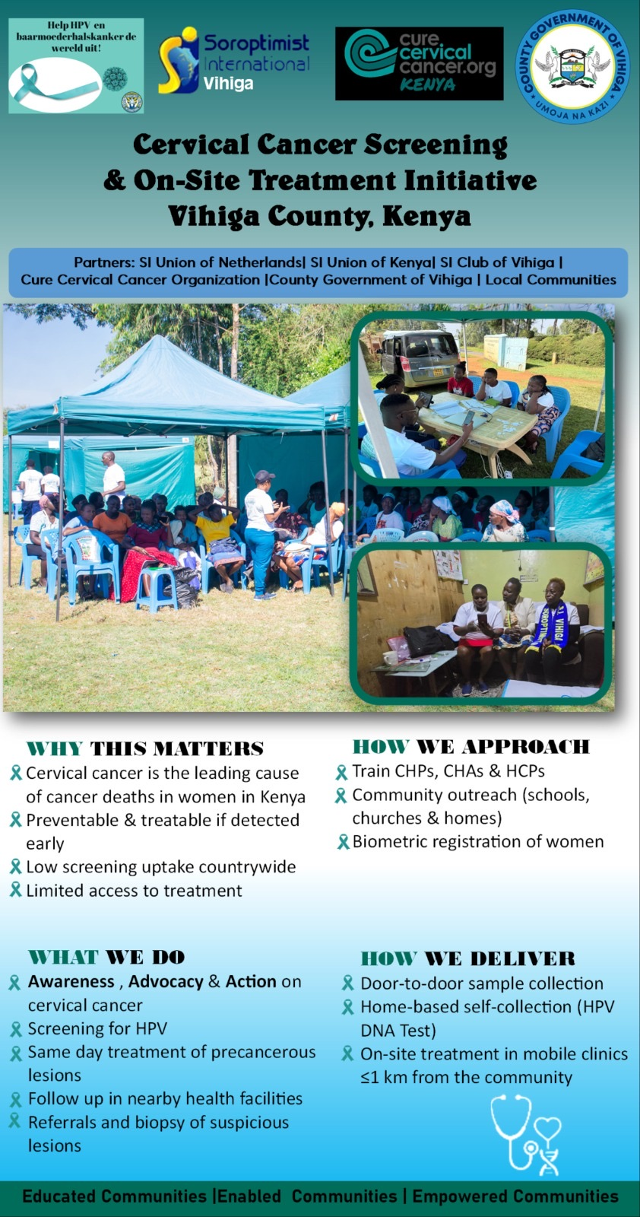

Slide 4
ACHIEVEMENTS
10,140 Women screened using HPV test (target was 10,000 women)
338 Community Health Promoters trained
30 Community Health Assistants trained
30 Nurses and Clinicians trained.
Community education and mobilization done
2218 women with precancerous lesions treated,( out of 2524)
42 women with suspicious lesions referred to JOOTRH for biopsy.

Slide 5
CHALLENGES
Low treatment uptake in the community outreaches, 82 clients declined treatment due to interruption in sexual intercourse
Loss to follow up of some clients although tracing still ongoing
Bad weather especially in the afternoon

Slide 6
Areas supported
Transport for CHPs and CHAs during training
CHAs and CHPs stipend during sample collection
Fuel during sample collection, verification and transport of samples
Purchase of CHP bags and ziplock bags for 50 CHPs
Purchase of treatment commodities like speculums , medications for STI management prior to treatment, payments of health care workers.
TOTAL AMOUNT SPENT-418,180 KSH (2772.89)
TOTAL GIVEN 450,000KSH (2983.89 Euros)

Slide 7
Next steps
Follow up on 658 clients who missed treatment in Hamisi,forward referral to nearest health facility for management.
Conduct a county and sub-county debrief meeting to share the lessons learnt and gaps, for improvement during the next phase.
Implementation of the project at Emuhaya Sub County from June 2026, targeting to screen 5000 women

Slide 8
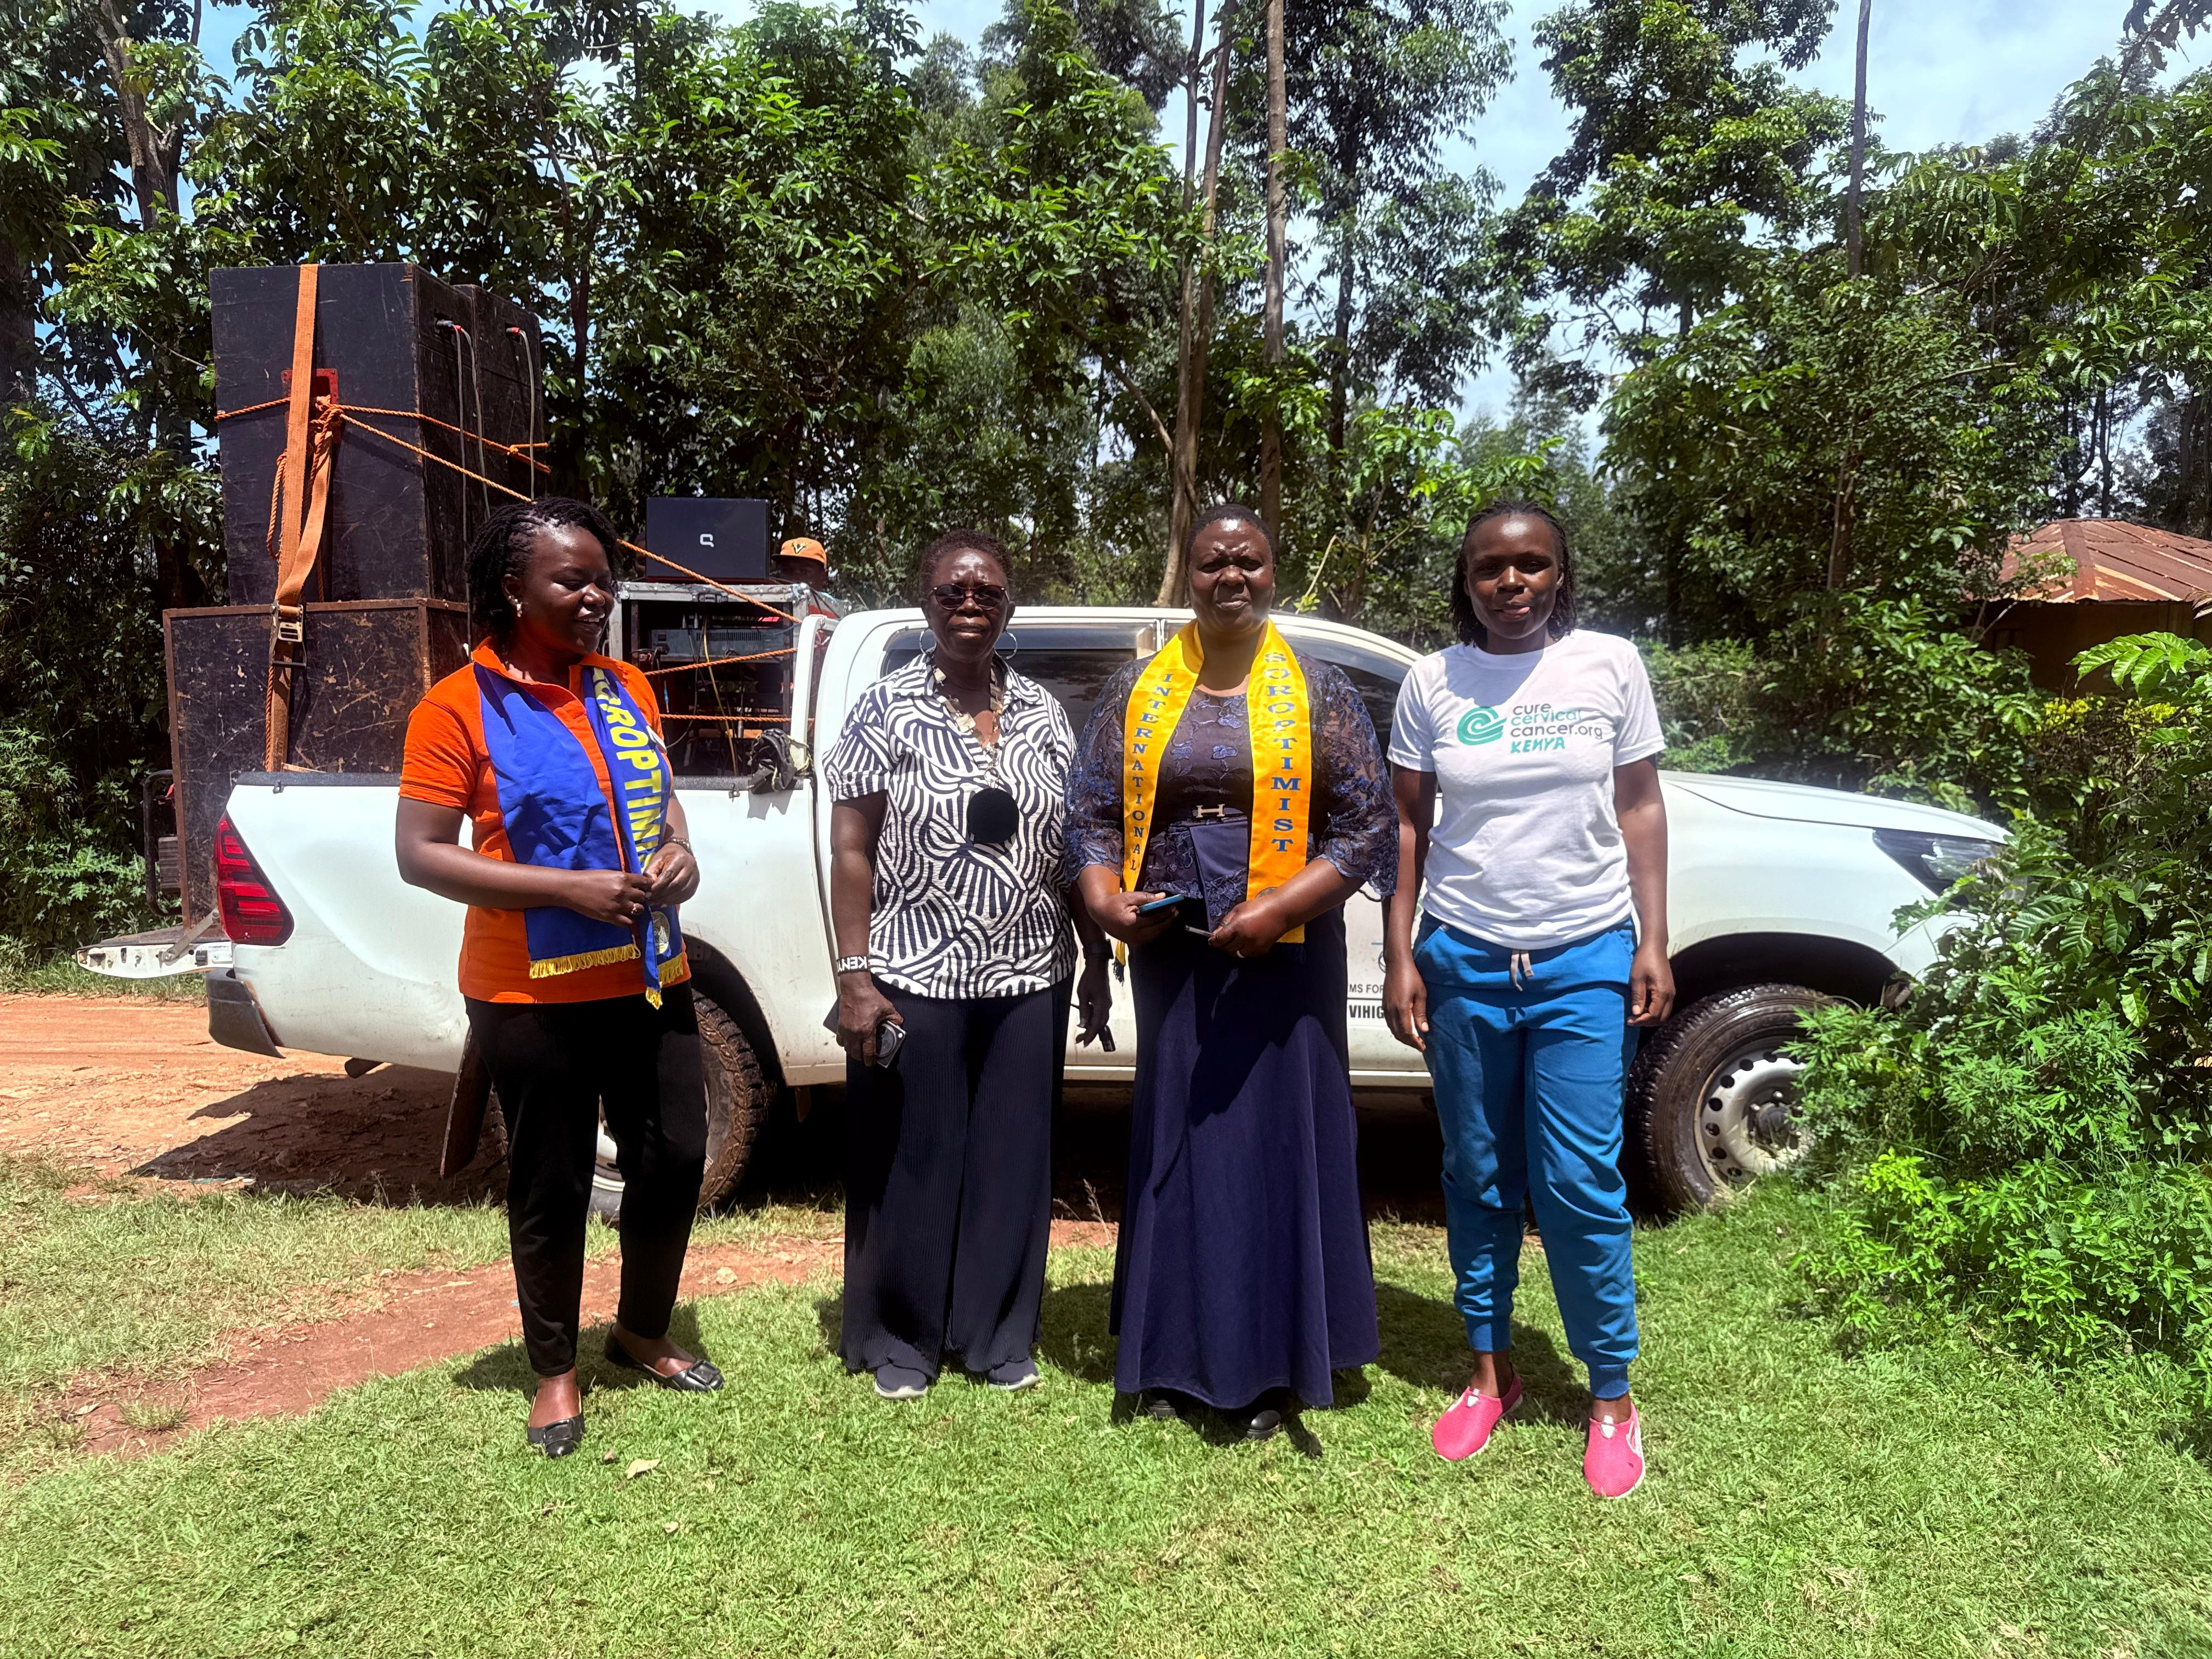
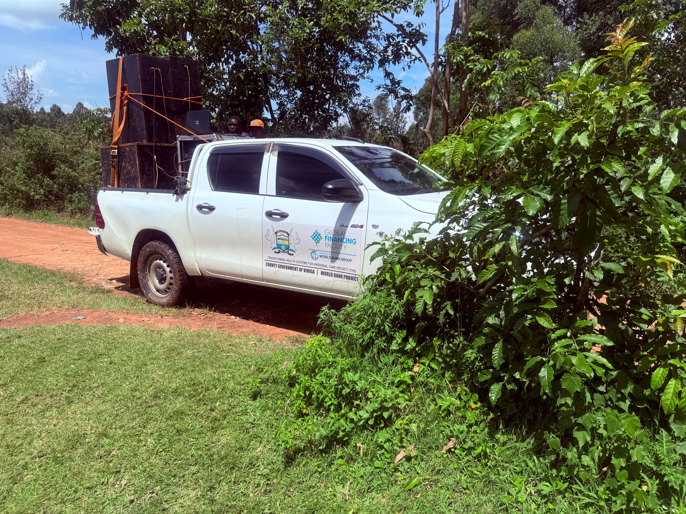

Slide 9
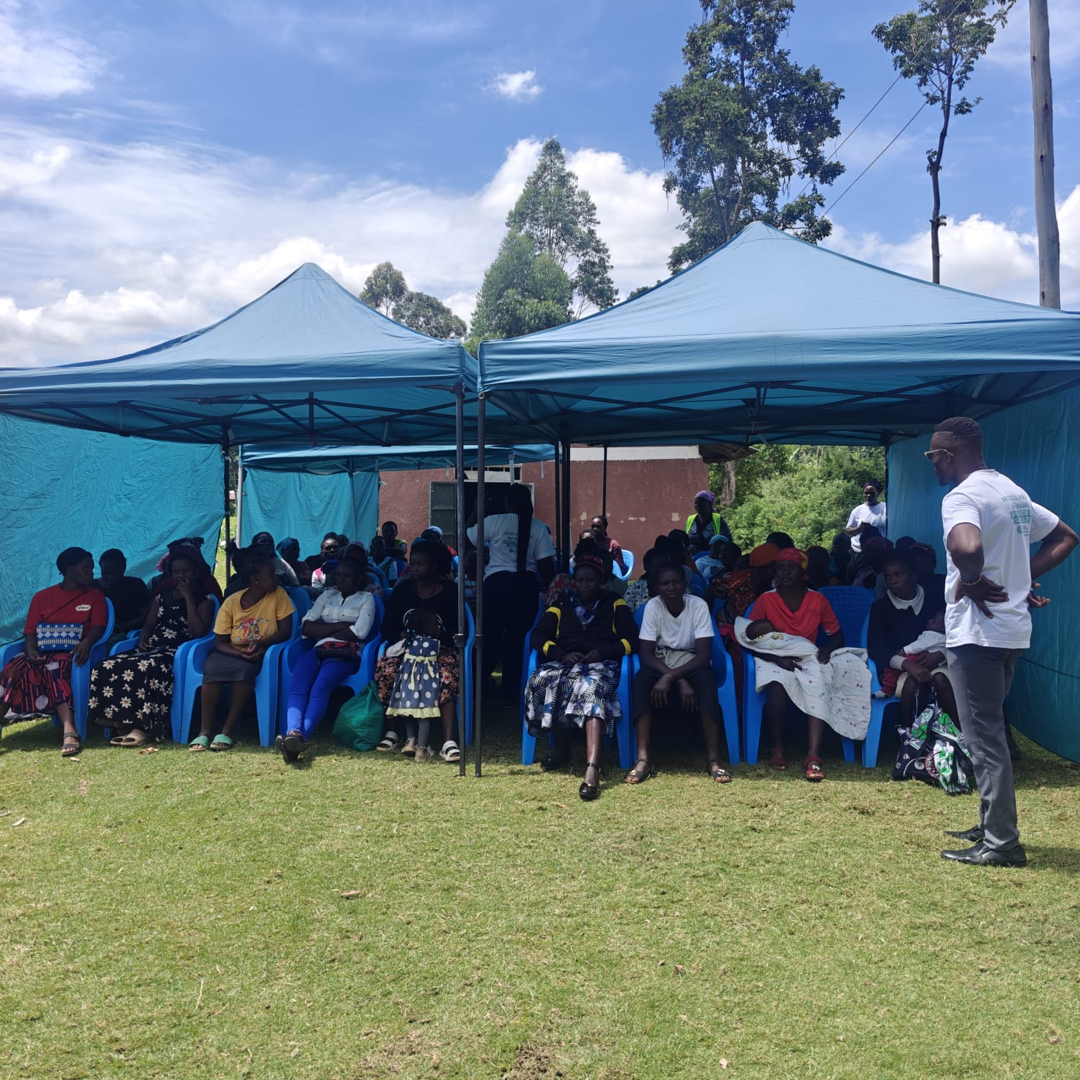
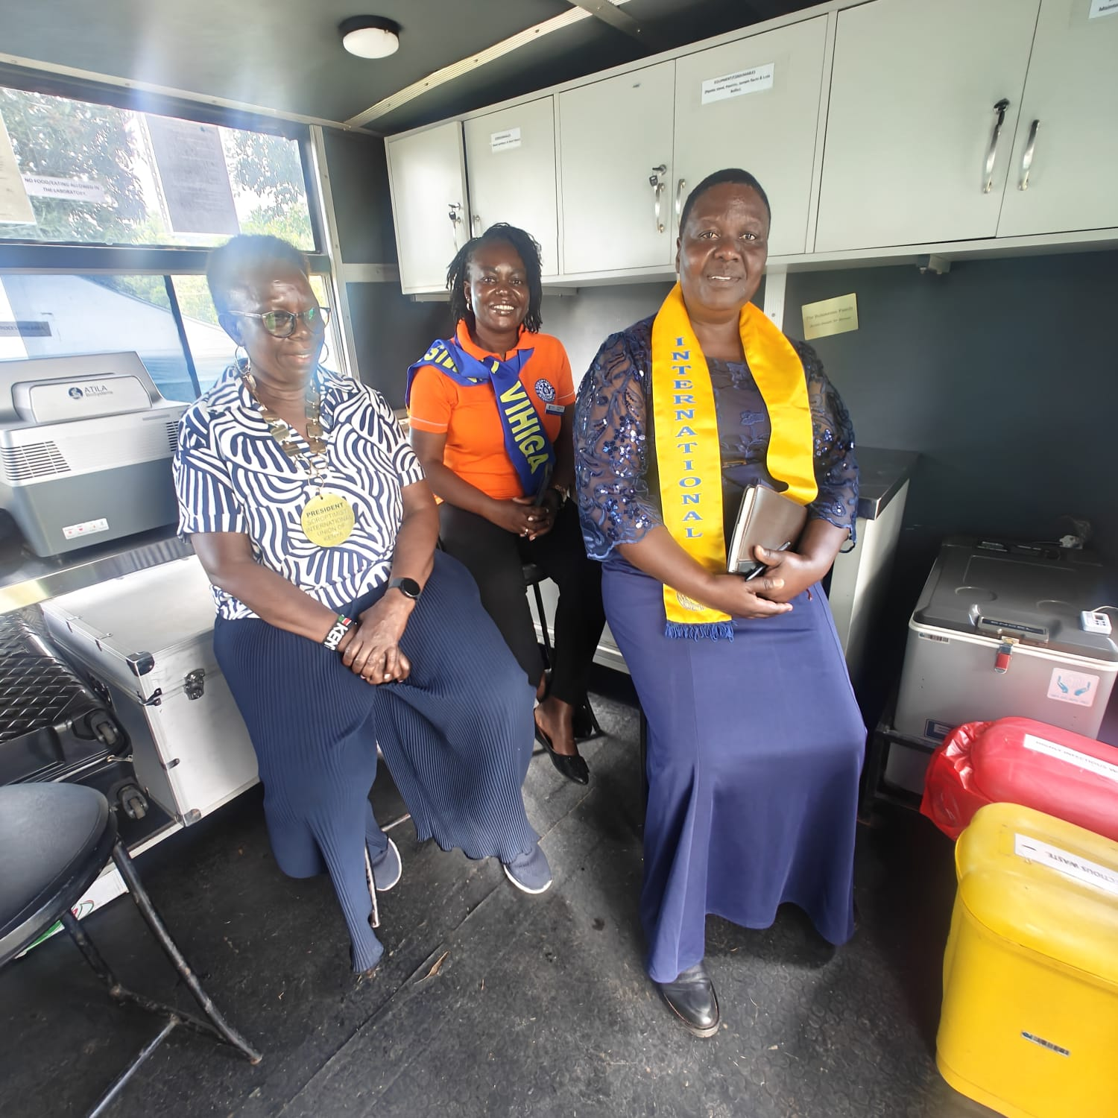

Slide 10
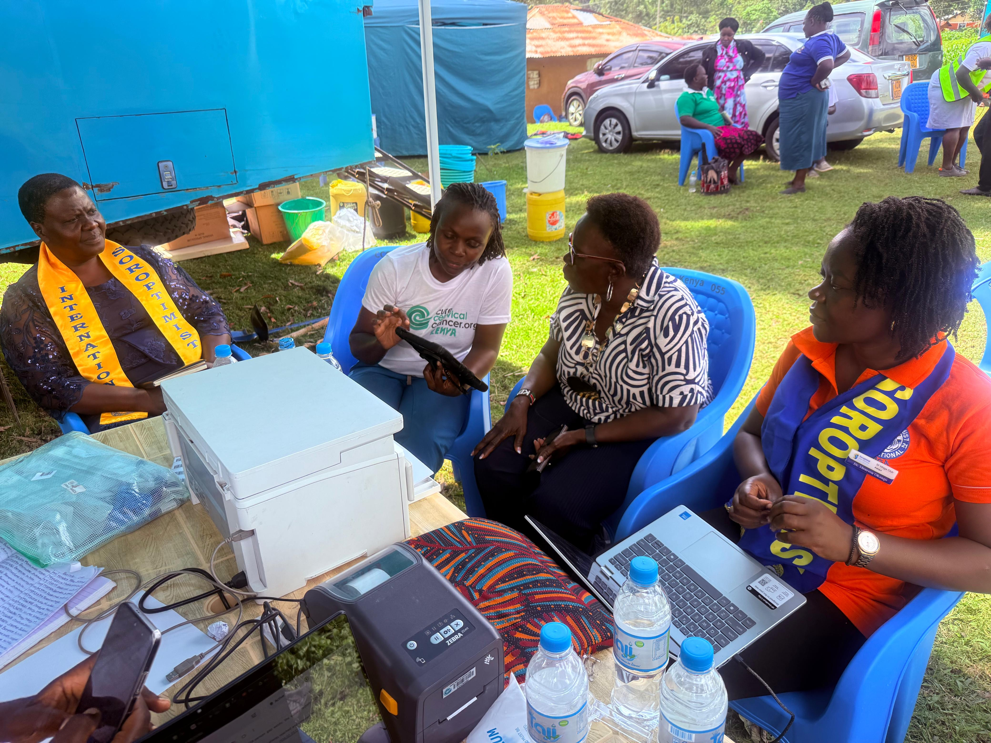

Slide 11
Dankuwel

